Slide 1

Common Probability Distributions

Slide 2
Learning Objectives
By the end of this session, you will be able to:
Understand the concept of random variable and probability distributions.
Understand Normal, Binomial, and Poisson Distributions.
Learn the formulas, attempt quizzes and solve numerical problems.
How to work with probability distributions using Python!

Slide 3
Random Variable Example
Number of sixes that will be hit in the last over of a T20 match?

Slide 4
Random Variable Example
Number of sixes that will be hit in the last over of a T20 match?
No of sixes | 0 | 1 | 2 | 3 | 4 | 5 | 6
A random variable is a variable that takes on different values based on the outcome of a random event.
It can be thought of as a function that assigns numerical values to each possible outcome of a random process.

Slide 5
Types of Random Variable
Discrete Random Variable: Takes on a countable number of distinct values (e.g., number of heads in a series of coin flips).
Continuous Random Variable: Takes on an infinite number of possible values within a given range (e.g., the exact height of students in a class).

Slide 6
Types of Distributions
Discrete Distributions: Binomial, Poisson
Continuous Distributions: Normal, Exponential

Slide 7
What is a Probability Distribution?
A probability distribution is a function that describes the likelihood of outcomes in a sample space.
Examples include: Normal, Binomial, Poisson

Slide 8
What is a Probability Distribution?
Ex: Consider the random experiment of tossing two coins.
Let the occurrence of heads to be counted. There may be 0, 1 or 2 heads.
Possible outcomes | TT | HT | TH | HH
Number of heads | 0 | 1 | 1 | 2
Probability | ¼ | ¼ | ¼ | ¼
A probability distribution describes how the values of a random variable are distributed. It provides a complete description of the likelihood of different outcomes.

Slide 9
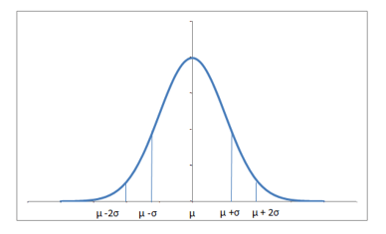
Normal Distribution
A continuous distribution with a symmetric, bell-shaped curve.
Defined by mean (μ) and standard deviation (σ).

Slide 10
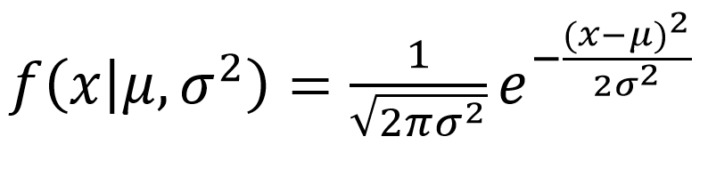
Normal Distribution - formula
Mean = Median = Mode
68-95-99.7 Rule
Symmetrical shape

Slide 11
Normal Distribution - Example
If height ~ N(170, 10), what is the probability a person is between 160 and 180 cm?

Slide 12
Normal Distribution – Example Solution
If height ~ N(170, 10), what is the probability a person is between 160 and 180 cm?
Z = (x - μ)/σ → Z = (180 - 170)/10 = 1
P(-1 < Z < 1) = 68%
Hence, 68% of people are between 160 and 180 cm

Slide 13
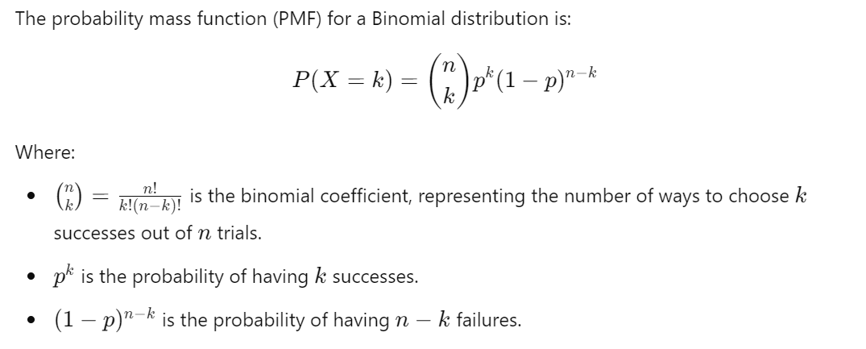
Binomial Distribution
Models the number of successes in n independent trials with probability p.
Used for yes/no outcomes.

Slide 14
Binomial Distribution Properties
Discrete distribution
Fixed number of trials (n)
Constant probability (p)
Independent trials

Slide 15
Binomial Distribution example
In an inspection of cement companies 60% of all industries had emissions that do not meet the pollution requirement. For a random sample of 15 companies, compute the following
Probability that all 15 fails the inspection
Exactly 8 fails the inspection

Slide 16
Binomial Distribution example
In an inspection of cement companies 60% of all industries had emissions that do not meet the pollution requirement. For a random sample of 15 companies, compute the following
Probability that all 15 fails the inspection
Exactly 8 fails the inspection
Given:
n = 15
p = 0.60
q = 1-p = 1-0.6 = 0.4
Probability that all 15 fails the inspection
Here x = 15
P(x) = ^{n}C_{x} p^{x}q^{n-x}, x: 0,1,2….,n
P(x=15) = ¹⁵C₁₅ (0.6)¹⁵(0.4)⁰
P(X=15) = 0.00047

Slide 17
Binomial Distribution example
In an inspection of cement companies 60% of all industries had emissions that do not meet the pollution requirement. For a random sample of 15 companies, compute the following
Probability that all 15 fails the inspection
Exactly 8 fails the inspection
Given:
n = 15
p = 0.60
q = 1-p = 1-0.6 = 0.4
Probability that exactly 8 fails the inspection
Here x = 8
P(x) = ^{n}C_{x} p^{x}q^{n-x}, x: 0,1,2….,n
P(x=8) = ¹⁵C₈ (0.6)⁸(0.4)¹⁵⁻⁸
P(x=8) = ¹⁵C₈ (0.6)⁸(0.4)⁷
P(X=8) = 0.17708

Slide 18
Poisson Distribution
Sometimes there may be a situation that out of a large number of trials, probability of getting a success may be very small i.e., the event may be a rare event.
Ex: Cyber attack, Fraud, Probability of a tree falling on someone’s head.
In this kind of situation where the occurrence of event is very rare Poisson distribution may be used.
Poisson distribution is the limiting case of binomial distribution. Under the following conditions binomial distribution tend to Poisson distribution.
There are infinite number of trials; n → α
Probability of getting an event is very small p→0
The product ‘np’ is constant np = λ

Slide 19
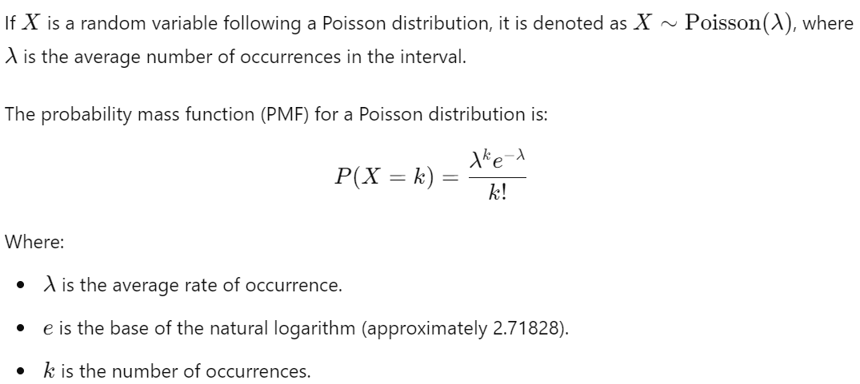
Poisson Distribution

Slide 20
Properties of Poisson Distribution
Mean = λ
Variance = λ
In Poisson distribution Mean = Variance
Standard deviation = Sqrt(Variance)

Slide 21
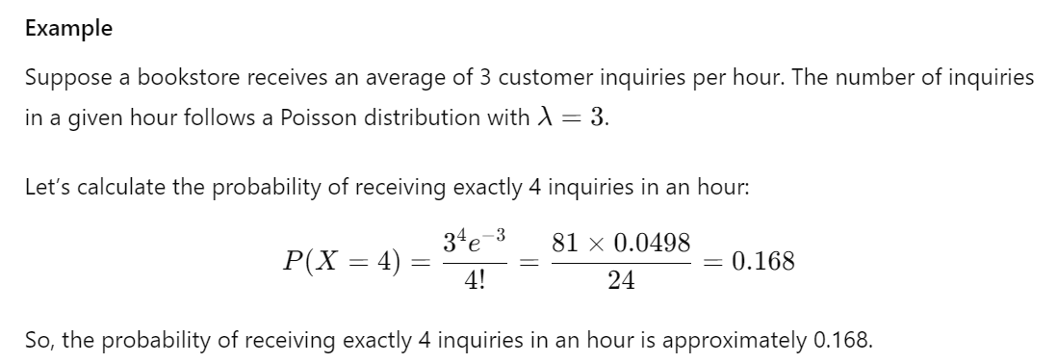

Slide 22
How to perform Probability distributions using Python?

Slide 23
Comparison
Binomial: fixed trials, yes/no
Poisson: rare events over time
Normal: continuous data, bell curve

Slide 24
Multiple Choice Questions (MCQs)
What is a Random Variable?
a) A variable that takes deterministic values. b) A variable that always takes integer values. c) A constant that never changes. d) A variable that assigns numerical values to the outcomes of a random process.

Slide 25
Multiple Choice Questions (MCQs)
What is a Random Variable?
a) A variable that takes deterministic values. b) A variable that always takes integer values. c) A constant that never changes. d) A variable that assigns numerical values to the outcomes of a random process.

Slide 26
Multiple Choice Questions (MCQs)
Q1: Which distribution has mean = variance?
A) Normal
B) Binomial
C) Poisson
Q2: Which is used for yes/no trials?
A) Poisson
B) Binomial

Slide 27
Multiple Choice Questions (MCQs)
Q1: Which distribution has mean = variance?
A) Normal
B) Binomial
C) Poisson ✅
Q2: Which is used for yes/no trials?
A) Poisson
B) Binomial ✅

Slide 28
Session Summary
In this session, we have discussed about:
Understand the concept of random variable and probability distributions.
Understand Normal, Binomial, and Poisson Distributions.
Learn the formulas, attempt quizzes and solve numerical problems.
How to work with probability distributions using Python!

Slide 29
Reference Links
Top 15 Probability Distribution Questions for Data Science Interviews
Analyzing loan data with binomial and poisson distribution
Notebook
10 Must-Know Probability Concepts for Every Aspiring Statistician and Data Scientist
Top 20 Interview Questions on Descriptive and Inferential Statistics
10 Must-Know Statistics Interview Questions (With Real Examples & Formulas!)

Slide 30

THANK YOU
For any Query:
Website- www.onlinecu.in
Helpline no.: 1800 121 388 800

